Slide 1
Software Engineering Lab
Building .NET Applications on the Oracle Database with Microsoft Visual Studio
Lab 3 – ODP.Net
Oracle Stored Procedures connected layer

Slide 2
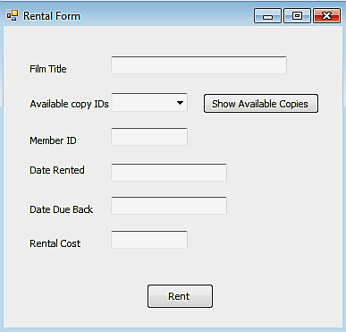
Inserting New Rental Information using Stored Procedure

Slide 3
What Is a Procedure?
Is a named PL/SQL block that can accept parameters and be invoked from a calling environment to perform an action.
A procedure can be stored in the database, as a schema object, for repeated execution.

Slide 4
Syntax for Creating Procedures
CREATE [OR REPLACE] PROCEDURE procedure_name
[(parameter1 [mode] datatype1,
parameter2 [mode] datatype2, ...)]
IS|AS
[local_variable_declarations; …]
BEGIN -- actions;
END [procedure_name];
PL/SQL Block
Notes:
Syntax for Creating Procedures
- You create new procedures with the CREATE PROCEDURE statement, which may declare a list of parameters and must define the actions to be performed by the standard PL/SQL block. The CREATE clause enables you to create stand-alone procedures that are stored in an Oracle database.
- PL/SQL blocks start with BEGIN, optionally preceded by the declaration of local variables. PL/SQL blocks end with either END or END procedure_name.
- The REPLACE option indicates that if the procedure exists, it is dropped and replaced with the new version created by the statement.
Other Syntactic Elements
parameter1 represents the name of a parameter.
The mode option defines how a parameter is used: IN (default), OUT, or IN OUT.
datatype1 specifies the parameter data type, without any precision.

Slide 5
Procedural Parameter Modes
Select one of the three modes for each parameter:
IN (default): Passes a constant value from the calling environment into the procedure
OUT: Passes a value from the procedure to the calling environment
IN OUT: parameter supplies an input value, which may be returned (output) as a modified value
Notes:
An OUT or IN OUT parameter must be assigned a value before returning to the calling environment
IN parameters can be assigned a default value in the parameter list.
OUT and IN OUT parameters cannot be
assigned default values

Slide 6
Calling Procedures From .Net Application
A- using SQL Developer
create the stored Procedure
B- using .Net Application
OracleConnection
OracleCommand
Connection
CommandText → procedure name
CommandType → storedprocedure
Parameters → In/Out
Execute Function

Slide 7
Handling SQL statements inside Stored Procedure
SQL statement | In Parameter | Out Parameter | Calling Procedure from .Net
Select Single row | Depends on the question (i.e. when input info from .Net should be passed to procedure) | Define output parameter for each column in the select statement | ExecuteNonQuery
Select Multiple rows |  | Define one output parameter with data type: Sys_refCursor | ExecuteReader
Insert/update/delete |  | Depends on the question | ExecuteNonQuery

Slide 8
Handling Select Statement inside stored procedure
If the procedure returns result set with :
- Single Row: Create the PL/SQL block in procedure with out parameters
SELECT columns INTO output parameters
- Multiple Rows: Create the PL/SQL block the procedure with sys_refcursor parameter
OPEN refcursor_name for
select statement
Notes:
The number of output parameters must be the same as the number of the columns in the select list

Slide 9
Sys_refcursor Parameter
A cursor variable that is passed as a parameter to stored procedure with a multi-row query.
Notes:
A ref cursor can be returned to a client. a plsql "cursor cursor" cannot be returned to a client.
A "normal" plsql cursor is static in definition. Ref cursors may be dynamically opened or opened based on logic.
The sys_refcursor is weakly typed, so you can return pointers to queries which not only have different from or where clauses, but different numbers and types of columns as well.
create function get_data ( type varchar2 )
return sys_refcursor
as
ret_cur sys_refcursor;
Begin
if type = 'EMP' then
open ret_cur for select * from emp;
elsif type = 'DEPT' then
open ret_cur for select * from dept;
end if;
return ret_cur;
end;
A "normal" PL/SQL cursor is static in definition. Refcursors may be dynamically opened or opened based on logic.
The refcursor is weakly typed, so you can return pointers to queries which not only have different from or where clauses, but different numbers and types of columns as well.

Slide 10
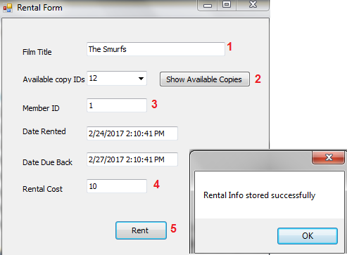
Rental form

Slide 11
Implementation Steps
1- Loading FilmCopies ComboBox with IDs of Available copies in showCopies_click event
2- Set DateRented with today’s date
3- Set Due Date with three days from the date the DVD is rented
4- To Insert a new rental, we must pass:
- RentID, MemberID, FilmCopyID, DateRented, Due Date, Rental Cost to Rental Table
- So we must store New value for RentID
5- Set the film status to RENTED

Slide 12
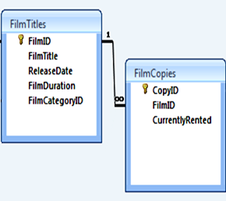
1- Loading FilmCopies ComboBox with Copy IDs
Call GetCopyID Procedure To Get Film Copy ID
create or replace procedure GetCopyID
(FTitle in varchar2 , CID out sys_refcursor)
as
begin
open CID for
select fc.CopyID
from FilmCopies fc , FilmTitles F
where fc.FilmID = F.FilmID and fc.CurrentlyRented = 'n' and
F.FilmTitle = Ftitle ;
end;

Slide 13
Procedure Compilation
Successful:
procedure procedureName Compiled.
Failed:
Warning: execution completed with warning
procedure procedureName Compiled.

Slide 14
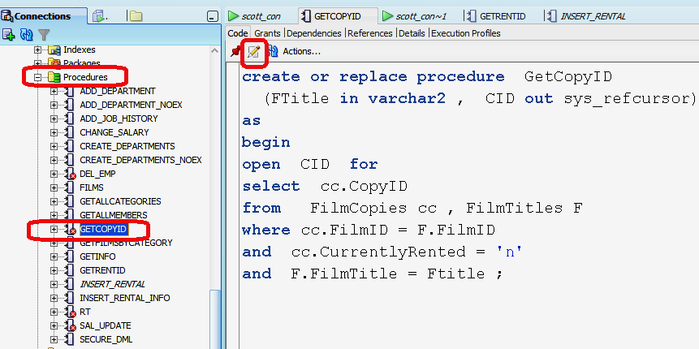
Edit Procedure Definition
Notes:
To edit procedure definition

Slide 15
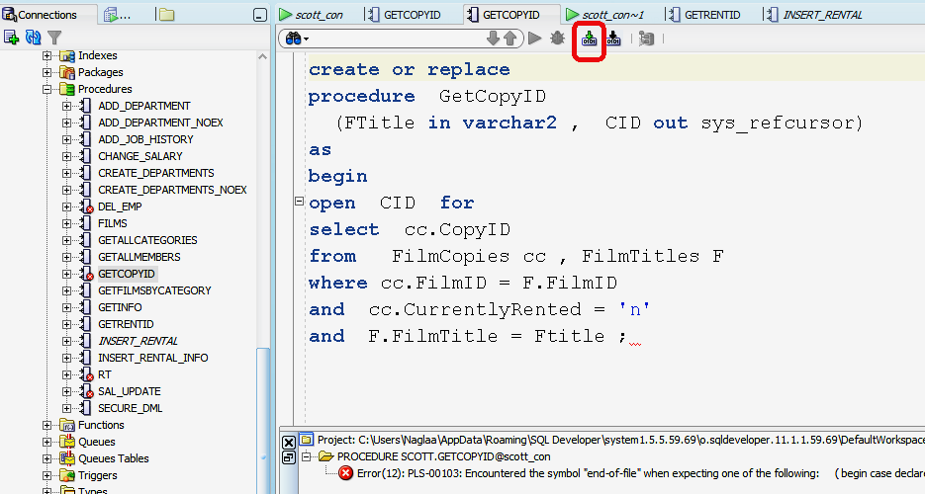
Edit Procedure and Correct Errors
End; is missing
Notes:
To compile

Slide 16
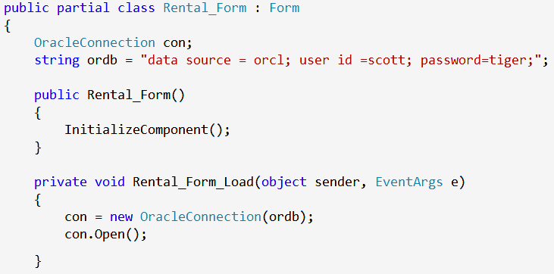
Creating Global Oracle Connection Object in .Net App

Slide 17
1- Loading FilmCopies ComboBox with Copy IDs in button_click event
Calling GetCopyID From .Net App:
- Create OracleCommand Object:
- Set CommandText property to the name of the stored procedure:
OracleCommand cmd = new OracleCommand();
cmd.Connection = con;
cmd.CommandText = "GetCopyID";

Slide 18
1- Loading FilmCopies ComboBox with Copy IDs in button_click event
Set the CommandType property to indicate that it is a stored procedure :
Add Command Parameters that represent:
Input Parameter
- the ref cursor output parameter
cmd.CommandType = CommandType.StoredProcedure;
cmd.Parameters.Add("title", txt_title.Text);
cmd.Parameters.Add("id", OracleDbType.RefCursor, ParameterDirection.Output);
Notes:
. You need to declare the parameter to be of typeOracleDbType.RefCursor, the direction is set to output.

Slide 19
1- Loading FilmCopies ComboBox with Copy IDs in button_click event
Execute the command
The result set (rows) will be returned in the RefCursor output parameter.
We can not directly fetch rows from cursor parameter.
Instead, we declare OracleDataReader object that will be implicitly linked to the result set (rows) returned into the RefCursor output parameter.
OracleDataReader dr = cmd.ExecuteReader();

Slide 20
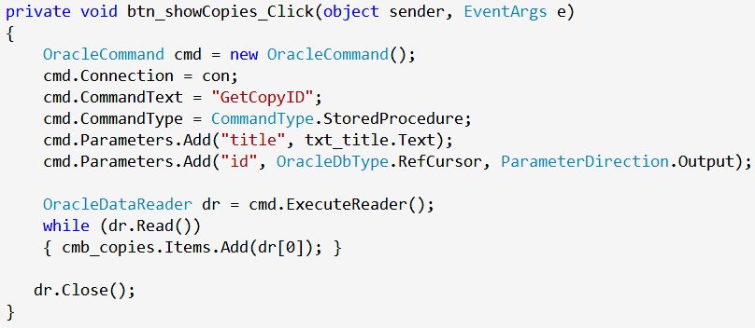
1- Loading FilmCopies ComboBox with Copy IDs in button_click event
Calling GetCopyID From .Net App:
Execution & Retrieving the results
Notes:
/* To read a result set from a REF cursor, you only need to add a REF cursor output parameter to the OracleCommand object. When you run the ExecuteDataReader() method on this OracleCommand object, it will create and return an OracleDataReader object that internally maps to the result set referenced by the REF cursor.*/

Slide 21
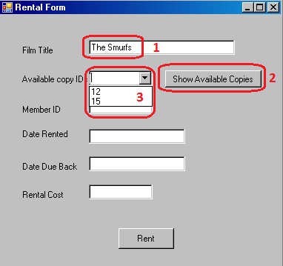
1- Loading FilmCopies ComboBox with Copy IDs in button_click event
Film title Example:
The Smurfs

Slide 22
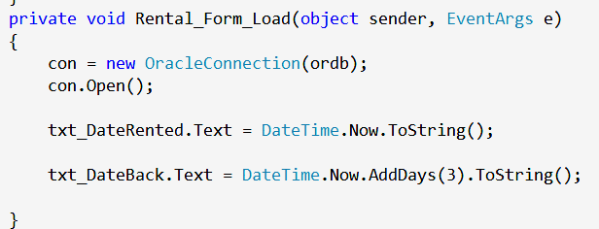
2- Set DateRented with today’s date
Using DateTime.Now Property:

Slide 23
3- Set Due Date with three days from the date the DVD is rented
Using AddDays() Function:

Slide 24
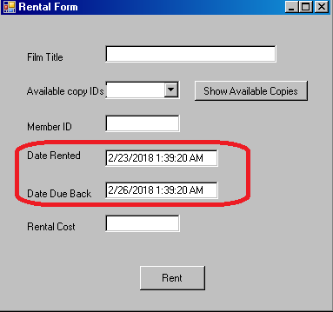
Set values for Date rented & Date_Due_Back

Slide 25
4- Insert New Rental Information
Procedure “GetRentID“ to get Max RentID from the rentals table
After returning the Max RentID, its value will be incremented by 1 and new value will be used as new rentID
Procedure “Insert_Rental” to insert new record in Rentals table
We must pass(RentID, MemberID, FilmCopyID, DateRented, Due Date, Rental Cost) To the insertion procedure.

Slide 26
4- Insert New Rental Information A. Create Proc “GetRentID”
Procedure “GetRentID“ to get Max RentID from the rentals table
create or replace procedure GetRentID (RID out number)
as
begin
select max(rentid)
into RID
from rentals;
end;

Slide 27
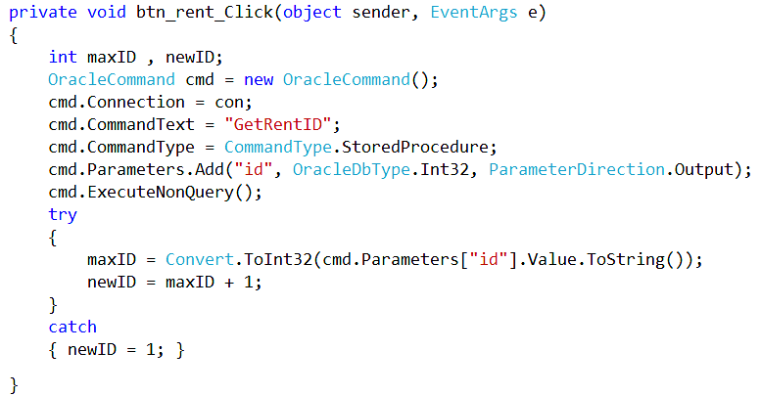
4- Insert New Rental Information A. calling “GetRentID”
Notes:
If table rentals has no rows, the output parameter value will be evaluated to null
In this case, try to convert the null value to int32 will throw an exception. Therefore we need to handle it between try and catch

Slide 28
4- Insert New Rental Information A. calling “GetRentID”
Syntax to read value from output parameter:
If the returned value is null, it will throw and exception. To avoid exceptions, write the above statement between try and catch.
It returns Object data type, we must cast the returned value to the required data type using convert.To (...) function
data_type variable_name= cmd.parameters["parameter_name"].Value.ToString())

Slide 29
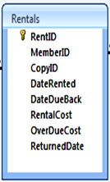
4- Insert New Rental Information B. Create Proc “Insert_rental”
Procedure “Insert_Rental” to insert new record in Rentals table
create or replace procedure Insert_Rental
(RID number, MID Number,CID Number,
DRented Date, DBack Date, Cost Number)
as
begin
insert into Rentals
(RentID, MemberID,CopyID, DateRented, DateDueBack, RentalCost)
Values ( RID, MID, CID, DRented, DBack, Cost) ;
End ;

Slide 30
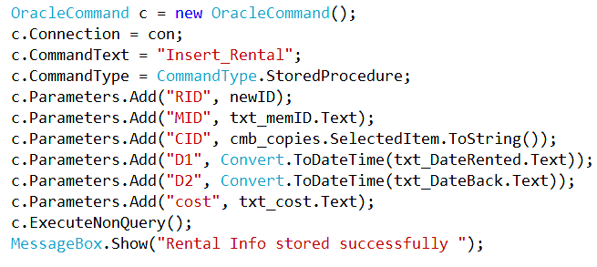
4- Insert New Rental Information B. calling “Insert_rental”
Calling The Procedure From .Net:
Continue in the btn_Rent_click event
Notes:
ExecuteNonQuery() → because the query is “insert” statement

Slide 31
4- Insert New Rental Information

Slide 32
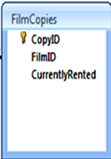
5- Set the film status to RENTED Create Proc. Update_status
create or replace procedure update_status
(CID Number)
as
begin
update FilmCopies
set CurrentlyRented = 'y'
where CopyID = CID ;
end;
Notes:
Pass Input Parameter (CopyID)
‘Y’ for Yes

Slide 33
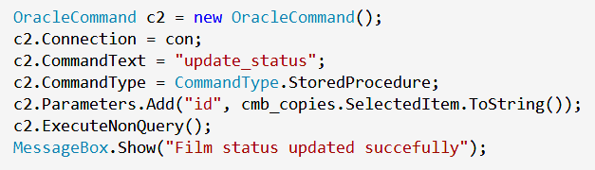
5- Set the film status to RENTED
Calling The Procedure From .Net:
Continue in the btn_Rent_click event
Notes:
*Call Con.Dispose(): because it’s the Final Step

Slide 34
Thank You

